Slide 1
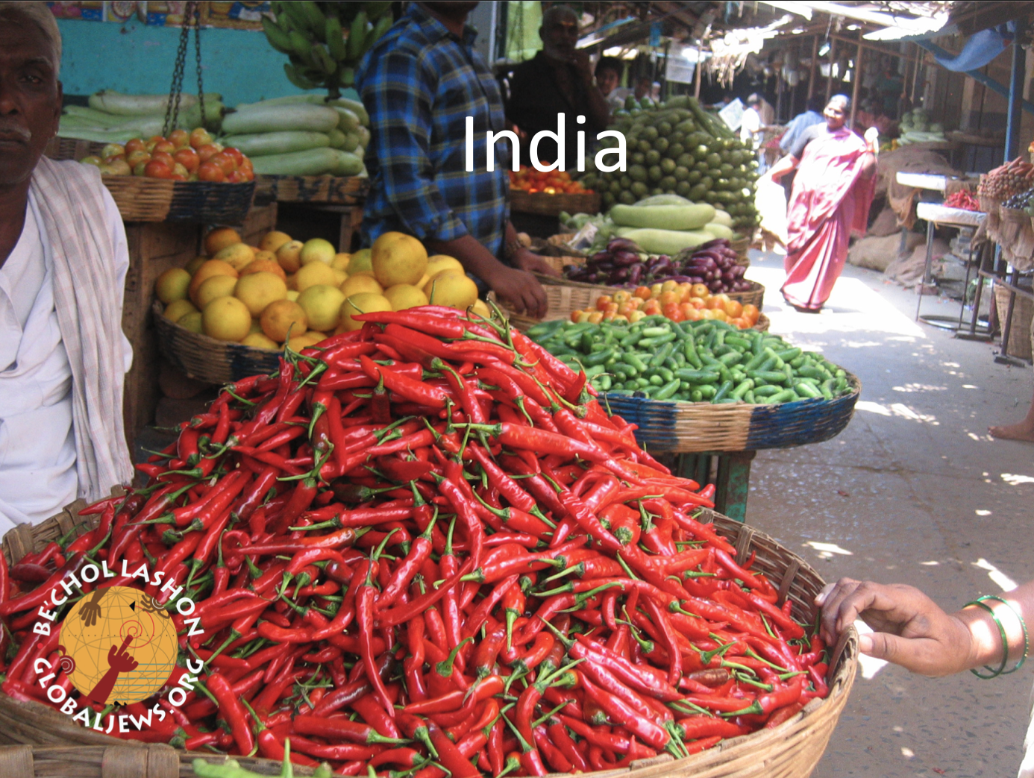
Note: This entire PowerPoint comes from Be’chol Lashon Global Jews.Org Use the direct link if it is still available rather than this PowerPoint. You will need to sign in: https://globaljews.org/learn/p2p/india/india-slideshow/

